Slide 1









Introduction to
Algorithm Design and Analysis
[11] Graph Traversal
Yu Huang
http://cs.nju.edu.cn/yuhuang Institute of Computer Software Nanjing University

Slide 2

In the last class…
Dynamic Equivalence Relation
Implementing Dynamic Set by Union-Find
Straight Union-Find
Making Shorter Tree by Weighted Union
Compressing Path by Compressing Find
Amortized Analysis of wUnion-cFind

Slide 3
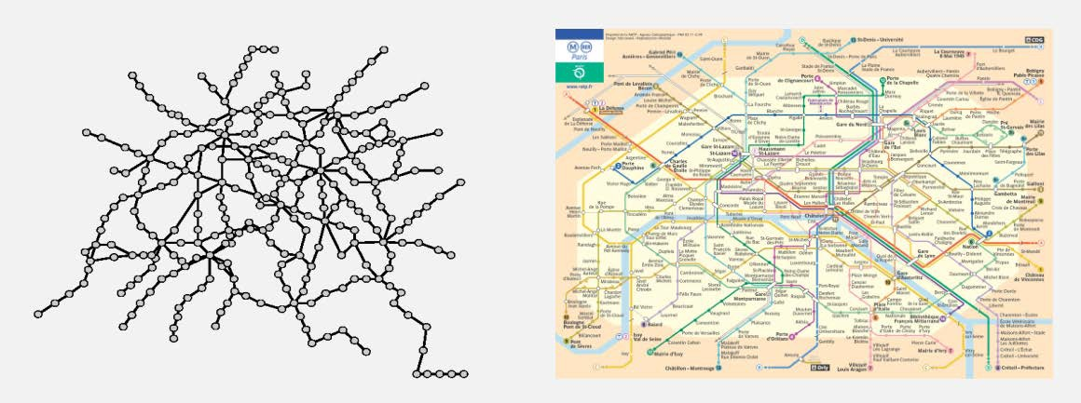
Graph Everywhere

Slide 4
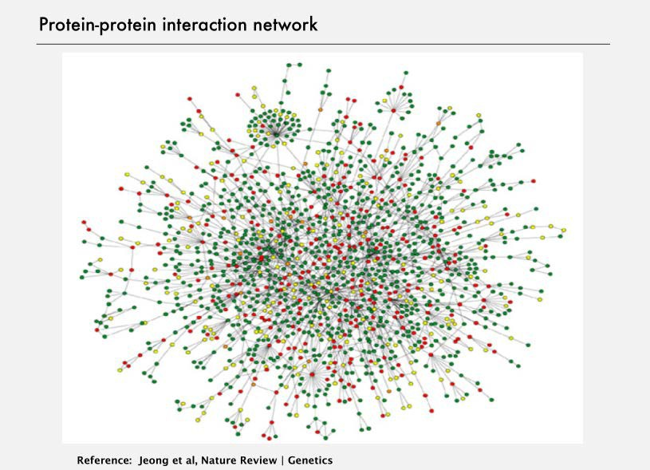

Slide 5


Slide 6


Slide 7


Slide 8


Slide 9


Slide 10


Graph Basics
Node
Entities of interest
V(G)
Edge
Relations of interest
o 𝐸𝐸(𝐺𝐺) ⊆ 𝑉𝑉 × 𝑉𝑉

Slide 11

Graph Traversals
Depth-First and Breadth-First Search
Finding Connected Components
General Depth-First Search Skeleton
Depth-First Search Trace

Slide 12
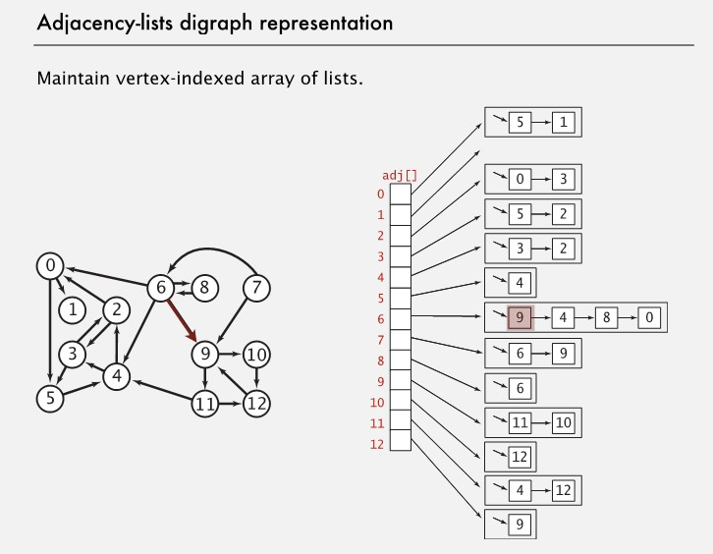
Directed vs. Undirected graphs

Slide 13
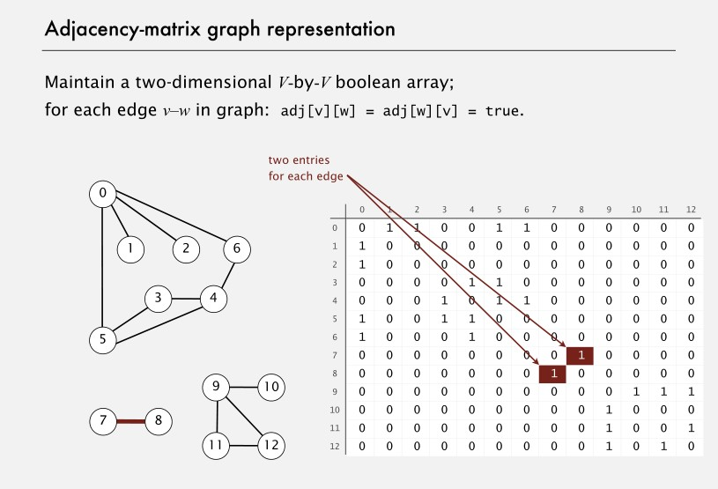

Slide 14







Graph Traversal
Starting node
A
D
Not reachable
B
G
Breadth-First Search
Starting node
F C
E
A
D
Depth-First Search
B
G
Edges only “checked”
F C
E
Not reachable

Slide 15


Slide 16







Outline of Depth-First Search
A vertex must be exact one of three different status:
dfs(G,v)
Mark v as “discovered”.
For each vertex w that edge vw is in G:
•
•
•
“Check” vw without visiting w.
Mark v as “finished”.
undiscovered
discovered but not finished
finished
If w is undiscovered: dfs(G,w)
Otherwise:
That is: exploring vw, visiting w, exploring from there as much as possible, and backtrack from w to v.

Slide 17




Outline of Breadth-First Search
Bfs(G,s)
Mark s as “discovered”;
enqueue(pending,s);
while (pending is nonempty)
dequeue(pending, v);
For each vertex w that edge vw is in G:
If w is “undiscovered”
Mark w as “discovered” and enqueue(pending, w)
Mark v as “finished”;
•

Slide 18


Finding Connected Components
Input: a symmetric digraph G, with n nodes and 2m edges(interpreted as an undirected graph), implemented as a array adjVertices[1,…n] of adjacency lists.
Output: an array cc[1..n] of component number for each node v_{i}
void connectedComponents(Intlist[ ] adjVertices, int n, int[ ] cc) // This is a wrapper procedure
int[ ] color=new int[n+1];
•
<Initialize color array to white for all vertices>
for (v=1; v≤n; v++)
if (color[v]==white)
•
•
int v;
Depth-first search
ccDFS(adjVertices, color, v, v, cc);
return

Slide 19





ccDFS: the procedure
void ccDFS(IntList[ ] adjVertices, int[ ] color, int v, int ccNum, int [ ]
cc)//v as the code of current connected component
•
•
int w;
IntList remAdj;
The elements of remAdj are neighbors of v
color[v]=gray;
cc[v]=ccNum;
remAdj=adjVertices[v];
while (remAdj≠nil)
w=first(remAdj);
if (color[w]==white)
•
•
•
•
Processing the next neighbor, if existing, another depth-first search to be incurred
ccDFS(adjVertices, color, w, ccNum, cc); remAdj=rest(remAdj);
color[v]=black;
return
v finished

Slide 20

Analysis of CC Algorithm
connectedComponents, the wrapper
Linear in n (color array initialization+for loop on adjVertices )
ccDFS, the depth-first searcher
In one execution of ccDFS on v, the number of instructions(rest(remAdj)) executed is proportional to the size of adjVertices[v].
Note: Σ(size of adjVertices[v]) is 2m, and the adjacency lists are traveresed only once.
So, the time complexity is in Θ(m+n)
Extra space requirements:
Color array
Activation frame stack for recursion

Slide 21

Visits On a Vertex
Classification for the visits on a vertex
First visit(exploring): status: white→gray
(Possibly) multi-visits by backtracking to: status keeps gray
Last visit(no more branch-finished): status: gray→black
Different operations can be done, during the different visits on a specific vertex
On the vertex
On (selected) incident edges

Slide 22







Depth-first Search Trees
DFS forest={(DFS tree1), (DFS tree2)}
Root of tree 1
_{A} B.E
B
D
G
T.E: tree edge B.E: back edge D.E: descendant
edge
C.E: cross edge
T.E
F
C
E
Root of tree 2
C.E
C.E
A finished vertex is never revisited, such as C

Slide 23





Depth-First Search – Generalized Skeleton
Input: Array adjVertices for graph G
Output: Return value depends on application.
int dfsSweep(IntList[] adjVertices,int n, …)
int ans;
<Allocate color array and initialize to white>
For each vertex v of G, in some order
if (color[v]==white)
int vAns=dfs(adjVertices, color, v, …);
<Process vAns>
// Continue loop
return ans;

Slide 24











Depth-First Search – Generalized Skeleton
int dfs(IntList[] adjVertices, int[] color, int v, …)
int w;
IntList remAdj;
int ans;
color[v]=gray;
<Preorder processing of vertex v>
remAdj=adjVertices[v];
while (remAdj≠nil)
w=first(remAdj);
if (color[w]==white)
•
•
•
•
•
•
•
•
•
If partial search is used for a application, tests for termination may be inserted here.
Specialized for connected components:
parameter added
preorder processing inserted – cc[v]=ccNum
<Exploratory processing for tree edge vw> int wAns=dfs(adjVertices, color, w, …);
< Backtrack processing for tree edge vw , using wAns> else
<Checking for nontree edge vw> remAdj=rest(remAdj);
<Postorder processing of vertex v, including final computation of ans> color[v]=black;
Lectu_{r}re_{e}s_{t}o_{u}n_{r}A_{n}lgo_{a}r_{n}ith_{s}m; Design & Analysis (LADA), 2015
2015/4/16
24

Slide 25



Breadth-First Search - Skeleton
Input: Array adjVertices for graph G
Output: Return value depends on application.
void bfsSweep(IntList[] adjVertices,int n, …)
int ans;
<Allocate color array and initialize to white>
For each vertex v of G, in some order
if (color[v]==white)
void bfs(adjVertices, color, v, …);
// Continue loop
return;
25

Slide 26




Breadth-First Search - Skeleton
void bfs(IntList[] adjVertices, int[] color, int v, …)
int w; IntList remAdj; Queue pending;
color[v]=gray;
•
•
•
•
•
•
remAdj=rest(remAdj);
<processing of vertex w>
color[w]=black;
return ;
enqueue(pending, v);
while (pending is nonempty)
w=dequeue(pending); remAdj=adjVertices[w]; while (remAdj≠nil)
x=first(remAdj);
can be further generalized
if (color[x]==white)
color[x]=gray;
enqueue(pending, x);
25

Slide 27

DFS vs. BFS Search
Processing opportunities for a node
Depth-first: 2
At discovering
At finishing
Breadth-first: only 1, when de-queued
At the second processing opportunity for the DFS, the algorithm can make use of information about the descendants of the current node.
25

Slide 28


Time Relation on Changing Color
Keeping the order in which vertices are encountered for the first or last time
A global interger time: 0 as the initial value, incremented with each color changing for any vertex, and the final value is 2n
Array discoverTime: the i th element records the time vertex v_{i} turns into gray
Array finishTime: the i th element records the time vertex v_{i} turns into black
The active interval for vertex v, denoted as active(v), is the duration while v is gray, that is:
discoverTime[v], …, finishTime[v]
25

Slide 29



Depth-First Search Trace
General DFS skeleton modified to compute discovery and finishing times and “construct” the depth-first search forest.
int dfsTraceSweep(IntList[ ] adjVertices,int n, int[ ] discoverTime, int[ ] finishTime, int[ ] parent)
int ans; int time=0
<Allocate color array and initialize to white>
For each vertex v of G, in some order if (color[v]==white)
parent[v]=-1
int vAns=dfsTrace(adnVertices, color, v, discoverTime, finishTime, parent, time );
// Continue loop return ans;
•
•
•
•
•
•
•
•
25

Slide 30
Depth-First Search Trace
int dfsTrace(intList[ ] adjVertices, int[ ] color, int v,
int[ ] finishTime, int[ ] parent int time)
int w; IntList remAdj; int ans;
color[v]=gray; time++; discoverTime[v]=time;
remAdj=adjVertices[v];
while (remAdj≠nil)
w=first(remAdj);
if (color[w]==white)
parent[w]=v;
•
int[ ] discoverTime,
int wAns=dfsTrace(adjVertices, color, w, discoverTime, finishTime,
parent, time);
else <Checking for nontree edge vw> remAdj=rest(remAdj);
time++; finishTime[v]=time; color[v]=black; return ans;
•
•
•
•
25

Slide 31

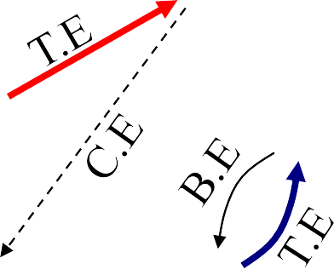
Active Interval
1/10 _{B.E} 5/6
A D
2/7
_{B G} 12/13
T.E
8/9 ^{F}
C
3/4
E
The relations are summarized in the next frame
C.E
C.E
11/14
Time
1 2 3 4 5 6 7 8 9 10 11 12 13 14
A
E G
B
F
C D
25

Slide 32



Properties of Active Intervals(1)
If w is a descendant of v in the DFS forest, then
active(w)⊆active(v), and the inclusion is proper if w≠v.
Proof:
Define a partial order <: w<v iff. w is a proper descendants of v in its DFS tree. The proof is by induction on <.
If v is minimal. The only descendant of v is itself. Trivial.
Assume that for all x<v, if w is a descendant of x, then active(w)⊆active(x).
Let w be any proper descendant of v in the DFS tree, there must be some x such that vx is a tree edge on the tree path to w, so w is a descendant of x. According to dfsTrace, we have active(x)⊂active(v), by inductive hypothesis, active(w)⊂active(v).
25

Slide 33



Properties of Active Intervals(2)
If active(w)⊆active(v), then w is a descendant of v. And if
active(w)⊂active(v), then w is a proper descendant of v.
That is: w is discovered while v is active.
Proof:
If w is not a descendant of v, there are two cases:
v is a proper descendant of w, then active(v)⊂active(w), so, it is impossible that active(w)⊆active(v), contradiction.
There is no ancestor/descendant relationship between v and w, then active(w) and active(v) are disjoint, contradiction.
25

Slide 34


Properties of Active Intervals(3)
If v and w have no ancestor/descendant relationship in the DFS forest, then their active intervals are disjoint.
Proof:
If v and w are in different DFS tree, it is trivially true, since the trees are processed one by one.
Otherwise, there must be a vertex c, satisfying that there are tree paths c to v, and c to w, without edges in common. Let the leading edges of the two tree path are cy, cz, respectively. According to dfsTrace, active(y) and active(z) are disjoint.
We have active(v)⊆active(y), active(w)⊆active(z). So, active(v) and active(w) are disjoint.
25

Slide 35

Properties of Active Intervals(4)
If edge vw∈E_{G}, then
o vw is a cross edge iff. active(w) entirely precedes active(v).
o vw is a descendant edge iff. there is some third vertex x, such that active(w)⊂active(x)⊂active(v),
o vw is a tree edge iff. active(w)⊂active(v), and there is no third vertex x, such that active(w)⊂active(x) ⊂active(v),
o vw is a back edge iff. active(v)⊂active(w),
25

Slide 36

Ancestor and Descendant
That w is a descendant of v in the DFS forest means that there is a direct path from v to w in some DFS tree.
The path is also a path in G.
However, if there is a direct path from v to w in G, is w necessarily a descendant of v in the DFS forest?
v_{k}
undiscovered
checked
v
^{v}k+2
k+1
At the moment before backtracking
v
k+3
25

Slide 37

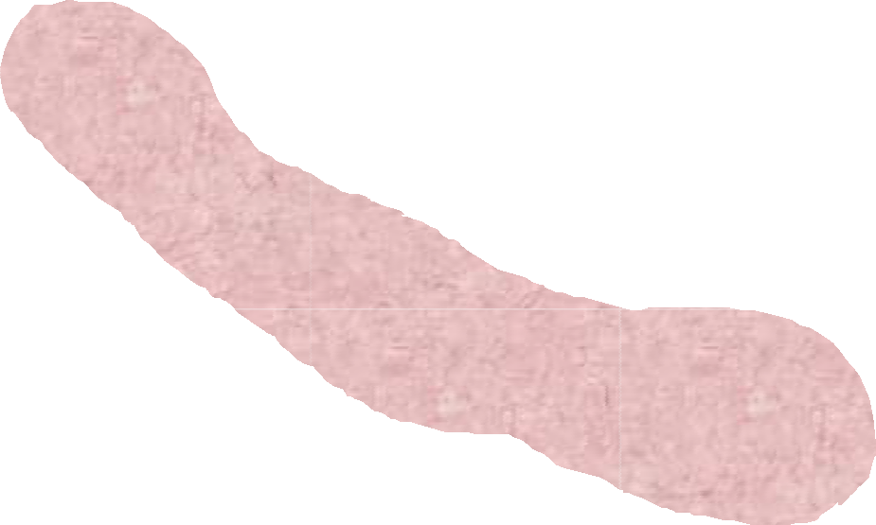
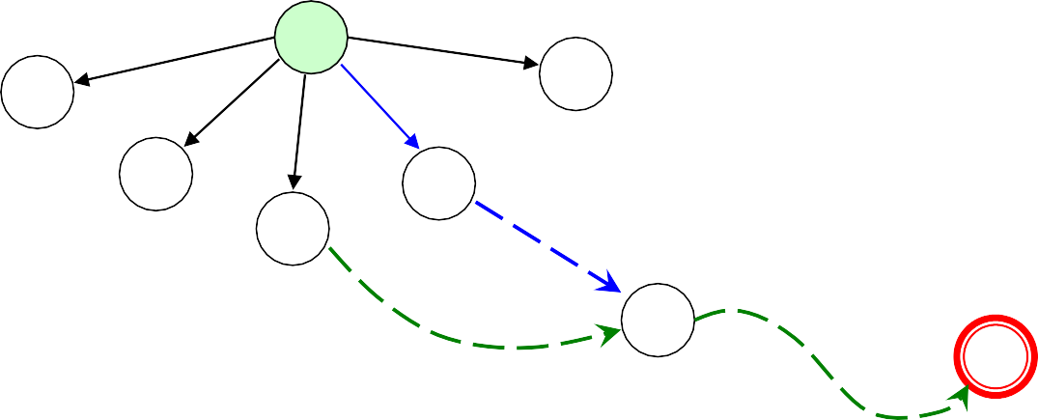
DFS Tree Path
[White Path Theorem] w is a descendant of v in a DFS tree iff. at the time v is discovered(just to be changing color into gray), there is a path in G from v to w consisting entirely of white vertices.
v
x₁
P₁
A white path from v to w
x_{i}
P₂
w
25

Slide 38


Proof of White Path Theorem
Proof
⇒ All the vertices in the path are descendants of v.
⇐ by induction on the length k of a white path from v to w.
When k=0, v=w.
For k>0, let P=(v, x₁,x₂,…x_{k}=w). There must be some vertex on P which is discovered during the active interval of v, e.g. x₁, Let x_{i} is earliest discovered among them. Divide P into P₁ from v to x_{i}, and P₂ from x_{i} to w. P₂ is a white path with length less than k, so, by inductive hypothesis, w is a descendant of x_{i}. Note: active(x_{i})⊆active(v), so x_{i} is a descendant of v. By transitivity, w is a descendant of v.
25

Slide 39




Thank you!
Q & A
Yu Huang
http://cs.nju.edu.cn/yuhuang
25

